Slide 1
ADVENTURES IN TLS Vitaly Shmatikov

Slide 2
SSL/TLS
Secure Sockets Layer and Transport Layer Security protocols
Same protocol design, different cryptographic algorithms
The de facto standard for Internet security
“The primary goal of the TLS protocol is to provide privacy and data integrity between two communicating applications”
Deployed in every Web browser (HTTPS); also mobile applications, payment systems, VoIP, many distributed systems, etc.

Slide 3
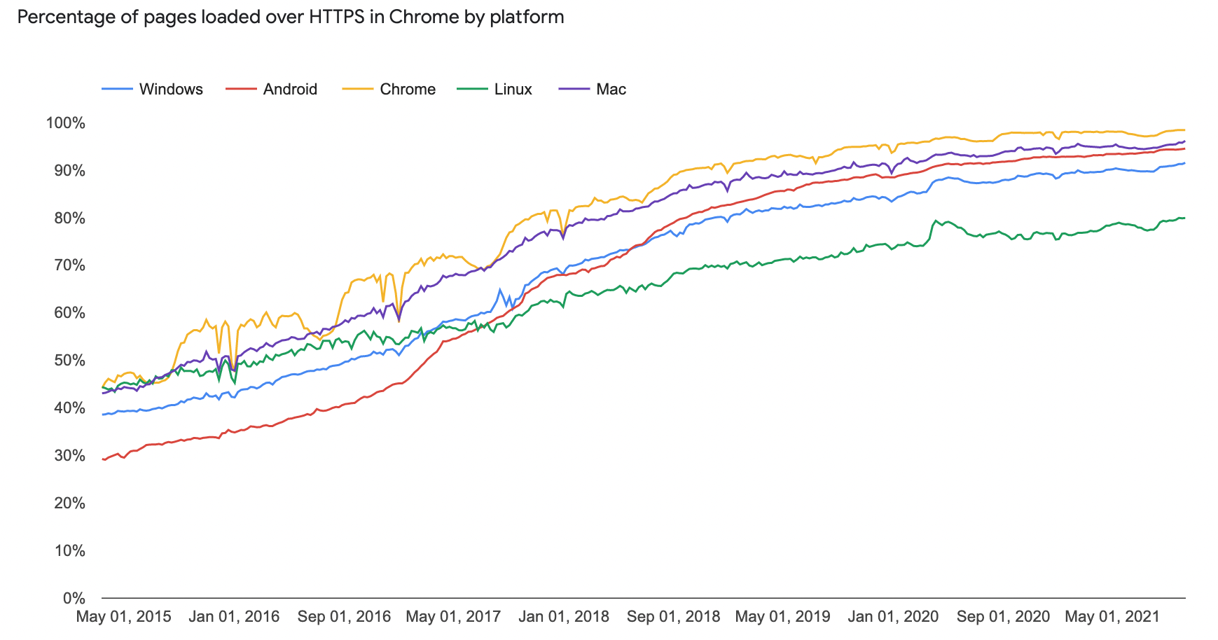
HTTPS Adoption by Websites
https://transparencyreport.google.com/https/overview

Slide 4
SSL / TLS Guarantees
End-to-end secure communications in the presence of a network attacker
Attacker completely 0wns the network: controls Wi-Fi, DNS, routers, his own websites, can listen to any packet, modify packets in transit, inject his own packets into the network
Scenario: you are reading your email from an Internet café connected via a r00ted Wi-Fi access point to a dodgy ISP in a hostile authoritarian country

Slide 5






TLS Threat Model
Remember TCP/IP, BGP, DNS attacks?
TLS is all that stands between us and oblivion…
DNS server
ISP1
Backbone
ISP2
ISP3
destination
but not the endpoints

Slide 6
Establishing a Secure Channel
Handshake protocol:
use public-key cryptography to authenticate each other, establish shared symmetric keys
Client
Server
Keys established
Record protocol:
use symmetric keys to protect confidentiality, integrity, authenticity of exchanged data
Data

Slide 7
SSL/TLS Handshake Protocol
Negotiate version of the protocol and the set of cryptographic algorithms to be used
Interoperability between different implementations
Authenticate server and client (optional)
Use digital certificates to learn each other’s public keys and verify each other’s identity
Often only the server is authenticated
Use public keys to establish a shared secret

Slide 8
“Core” SSL/TLS Handshake
C, version_{c}, suites_{c}, N_{c}
C
S
version_{s}, suite_{s}, N_{s},
certificate for PK_{s},
“ServerHelloDone”
{Secret_{c}}_{PKs} if using RSA
C and S share secret key material (secret_{c})
switch to keys derived
from secret_{c} , N_{c} , N_{s}
switch to keys derived
from secret_{c} , N_{c} , N_{s}
Finished
Finished

Slide 9
Termination,
Cookie Cutter
Source: Douglas Stebila
(2019-06-06)
Attacks on TLS
SLOTH
POODLE
ZombiePOODLE
GoldenDOODLE
Bleichenbacher
Debian OpenSSL
entropy bug
Crypto primitives
RSA, DSA, ECDSA
Diffie–Hellman, ECDH
DES, 3DES, RC4, AES
Ciphersuite details
Data structures
Key derivation
Advanced functionality
Renegotiation
Libraries
OpenSSL
HMAC
MD5, SHA1, SHA-2
Encryption modes, IVs
Padding
Session resumption
Alerts & errors
Certification / revocation
Applications
Web browsers: Chrome, Firefox, IE/Edge, Safari
Web servers: Apache, IIS, nginx, node, …
NSS
SChannel
Application SDKs
Java JSSE
Negotiation
Certificates
Key reuse
Compression
LibreSSL, BoringSSL
Export grade
State machine
Protocols
HTTP, IMAP, ..
GnuTLS
Everest / miTLS
s2n
Bleichenbacher,
Goldberg & Wagner Netscape PRNG attack
BEAST
SSL 2.0 downgrade,
FREAK, Logjam
Cross-protocol DH/ECDH attack
Heartbleed
Collisions
goto fail;
BERserk
High-STEKs
Lucky13
Selfie
Triple handshake attack
CA breaches
Ray & Dispensa
“Most dangerous code…”
MalloDroid
Frankencerts
Sweet32
Cross-protocol DH/ECDH attack
RC4 biases,
rc4nomore,
Bar Mitzvah
CRIME, BREACH, HEIST
Lucky microseconds
FREAK, Logjam
Jager et al.
DROWN
CCS injection
Virtual host confusion
STARTTLS injection
SMACK
SSL stripping

Slide 10


TLS Heartbeat
A way to keep TLS connection alive
without constantly transferring data
C
S
If you are alive, send me
this 5-letter word: “xyzzy”
“xyzzy”
OpenSSL omitted to check that this value matches the actual length of the heartbeat message
Per RFC 6520:
struct {
HeartbeatMessageType type;
uint16 payload_length;
opaque payload[HeartbeatMessage.payload_length];
opaque padding[padding_length];
} HeartbeatMessage;

Slide 11
Heartbleed Consequences
Attacker can obtain chunks of server memory
Passwords, contents of other users’ communications, even the server’s private RSA key
Assisted by a custom allocator that does not zero out malloc’d memory (for “performance,” natch!)

Slide 12
TLS with Diffie-Hellman
Ciphersuite is not signed
crypto suites (incl. DHE), N_{c}
S
C
DHE, N_{s},
certificate for RSA public key,
p, g, gª, sign_{RSAkey}(N_{c},N_{s},p,g,gª)
g^{b}
Integrity protection
C and S share secret g^{ab}
switch to derived keys
switch to derived keys
Finished
Finished

Slide 13
DH Downgrade by MITM
LOGJAM attack
crypto suites (incl. DHE), N_{c}
“Export-grade” DHE, N_{c}
S
C
DHE, N_{s},
certificate for RSA public key,
p, g, gª, sign_{RSAkey}(N_{c},N_{s},p,g,gª)
g^{b}
C and S share secret g^{ab}
“Export-grade” Diffie-Hellman:
97% of hosts use one of three 512-bit primes
With 1 week of precomputation, takes 70 seconds of real time to compute discrete log

Slide 14

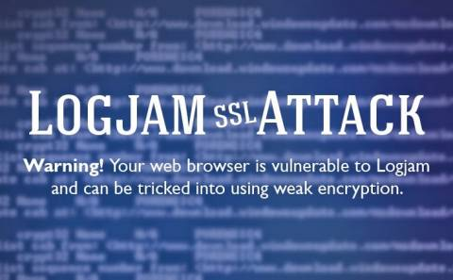

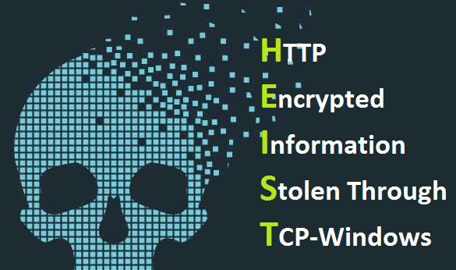
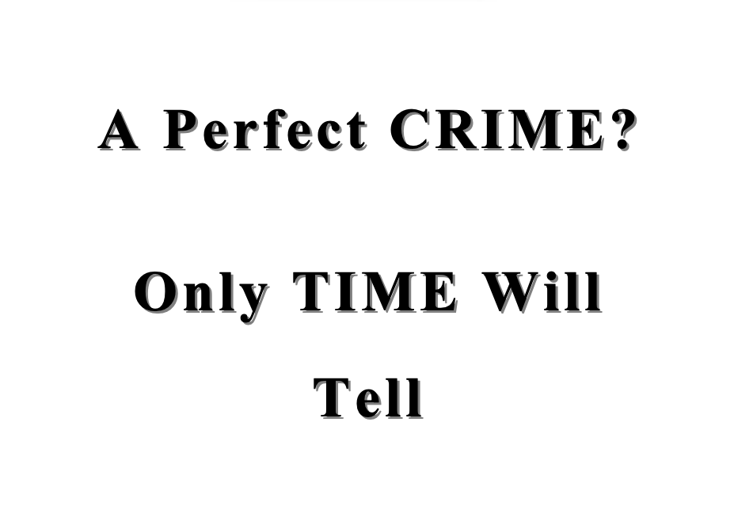
Padding oracles
Compression oracles
Downgrades to export cryptography
… many other attacks over the years

Slide 15
More Fun with Diffie-Hellman
crypto suites (incl. DHE), N_{c}
S
C
DHE, N_{s},
certificate for RSA public key,
p, g, gª, sign_{RSAkey}(N_{c},N_{s},p,g,gª)
g^{b}
C and S share secret g^{ab}
Validate the server’s certificate
switch to derived keys
switch to derived keys
… then verify the signature on the DH value using the public key from the certificate

Slide 16


MITM Presenting a Valid Certificate
Hello
I am PayPal.com (or whoever you want me to be)
Here is PayPal’s certificate for its RSA signing key
And here is my signed Diffie-Hellman value
Validate the server’s certificate
… then verify the signature on the DH value using the public key from the certificate

Slide 17
Goto Fail
Here is PayPal’s certificate
And here is my signed Diffie-Hellman value
… verify the signature on the DH value using the public key from the certificate
if ((err = SSLHashSHA1.update(&hashCtx, &clientRandom)) != 0)
goto fail;
if ((err = SSLHashSHA1.update(&hashCtx, &serverRandom)) != 0)
goto fail;
if ((err = SSLHashSHA1.update(&hashCtx, &signedParams)) != 0)
goto fail;
goto fail;
if ((err = SSLHashSHA1.final(&hashCtx, &hashOut)) != 0)
goto fail; …
err = sslRawVerify(...);
…
fail: … return err …
???
Signature is verified here

Slide 18
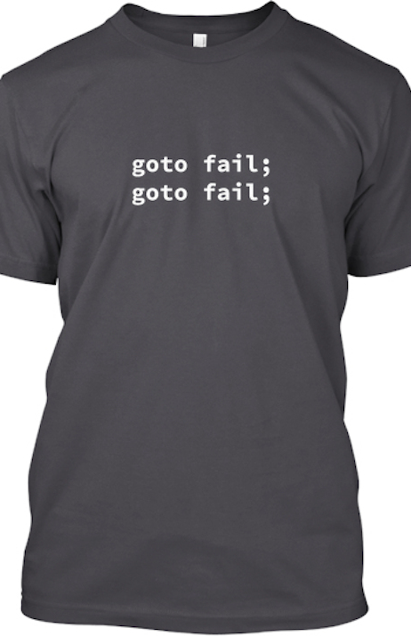
Complete Fail Against MITM
Discovered in February 2014
All OS X and iOS software vulnerable to man-in-the-middle attacks
Broken TLS implementation provides no protection against the very attack it was supposed to prevent
What does this tell you about quality control for security-critical software?

Slide 19
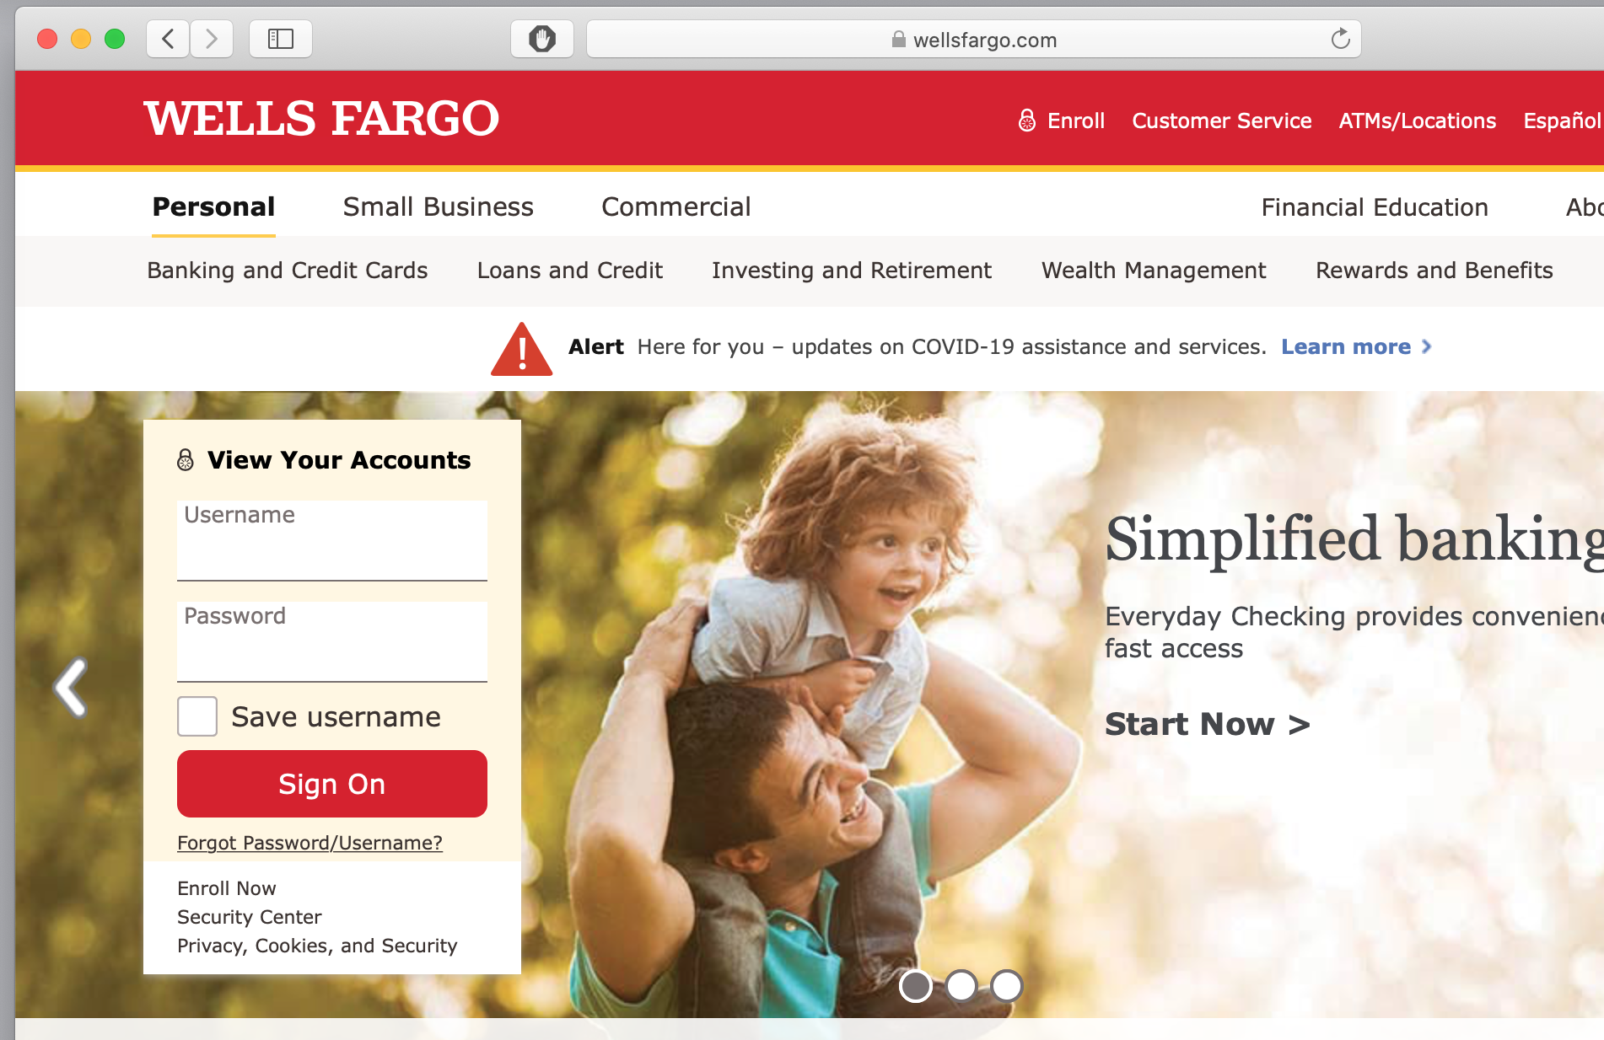

HTTPS: HTTP over SSL

Slide 20

HTTPS and Its Adversary Model
HTTPS: end-to-end secure protocol for Web
Goals: confidentiality, authentication (usually for server only), and integrity against network attackers, including man-in-the-middle (MITM) attacks
browser
proxy
Internet
HTTPS server
HTTPS tunnel

Slide 21
The Lock Icon
Goal: identify secure connection
SSL/TLS is being used between client and server to protect against active network attacker
Lock icon should only be shown when the page is secure against network attacker
Semantics subtle and not widely understood by users
Problem in user interface design

Slide 22

HTTPS Security Guarantees
The origin of the page is what it says in the address bar
Contents of the page have not been viewed or modified by a network attacker
User must interpret what he sees

Slide 23
HTTP → HTTPS and Back
Can the server detect this attack?
Common pattern: HTTPS upgrade
Come to site over HTTP, redirect to HTTPS for login
Browse site over HTTP, redirect to HTTPS for checkout
sslstrip: man-in-the-middle network attacker downgrades connection
HTTP
SSL
attacker
Rewrite <a href=https://…> to <a href=http://…>
Redirect Location: https://... to Location: http://...
Rewrite <form action=https://… > to <form action=http://…>

Slide 24
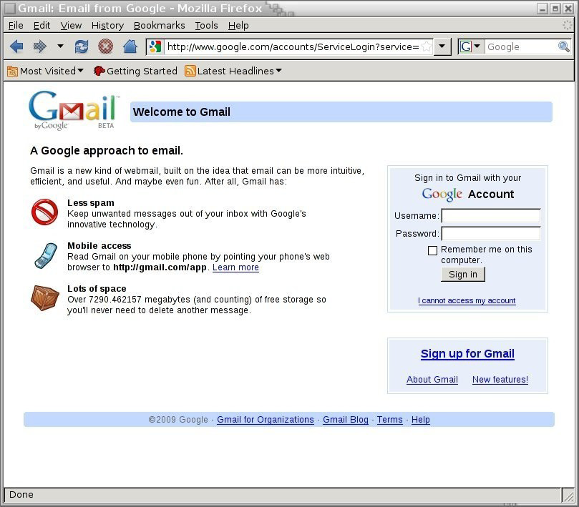
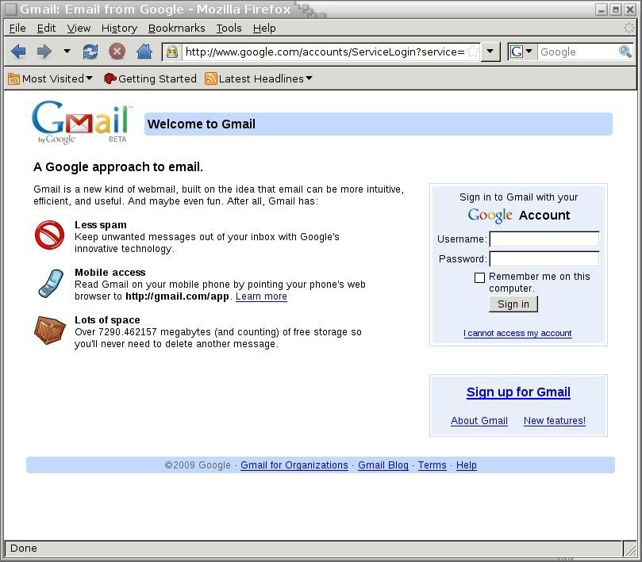
Will You Notice?
⇒
Clever favicon inserted
by network attacker
Source: Moxie Marlinspike

Slide 25

Encrypt all the things!
HTTPS EVERYWHERE!!!

Slide 26
HSTS: Strict Transport Security
Strict-Transport-Security: max-age=63072000; includeSubDomains
(ignored if not over HTTPS)
Header tells browser to always connect over HTTPS
Subsequent visits must be over HTTPS
Browser refuses to connect over HTTP or if site presents an invalid or self-signed cert
Requires that entire site be served over valid HTTPS
HSTS flag deleted when user “clears private data”: security vs. privacy

Slide 27

Preloaded HSTS List
https://hstspreload.org/
Strict-Transport-Security: max-age=63072000; includeSubDomains; preload
Preload list hard-coded in Chrome source code.
Examples: Google, Paypal, Twitter, Simple, Linode, Stripe, Lastpass, …

Slide 28
Using CSP to Upgrade to HTTPS
Problem: many pages use <img src=“http://site.com/img”>
Makes it difficult to migrate a section of a site to HTTPS
Solution: gradual transition using CSP
Content-Security-Policy: upgrade-insecure-requests
<img src=“http://site.com/img”>
<img src=“http://othersite.com/img”>
<a href=“http://site.com/img”>
<a href=“http://othersite.com/img”>
<img src=“https://site.com/img”>
<img src=“https://othersite.com/img”>
<a href=“https://site.com/img”>
<a href=“http://othersite.com/img”>

Slide 29
Authenticating the Server
Whose public key is used to
establish the secure session?

Slide 30
Public-Key Certificates
C, version_{c}, suites_{c}, N_{c}
C
S
version_{s}, suite_{s}, N_{s},
certificate for PK_{s},
“ServerHelloDone”
Signed statement saying that PK is S’s public key
Signed by whom?
How does client verify the signature?
What prevents an attacker from forging it?

Slide 31

Certificate Authorities
A public-key certificate is a signed statement specifying the key and identity
Could be signed by the subject itself (“self-signed”), but why would anyone trust such a certificate?
Instead: certificate authorities (CAs)
Agencies responsible for certifying public keys
Browsers are pre-configured with the public keys of 100+ of trusted CAs
A public key for any website in the world will be accepted by the browser
if the certificate is signed by one of these CAs
CAs hold “skeleton keys” to the entire Internet

Slide 32
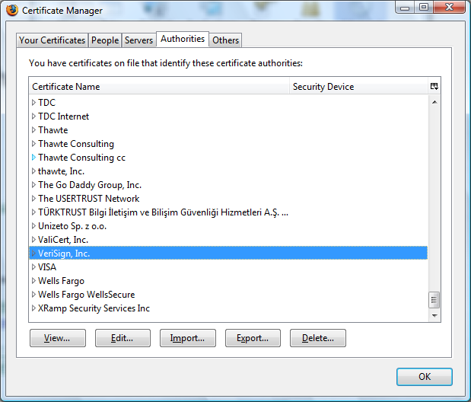
Trusted Certificate Authorities

Slide 33
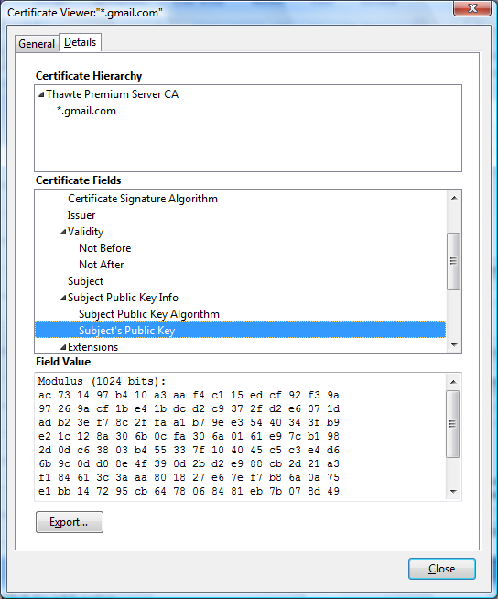


Example of a Certificate

Slide 34
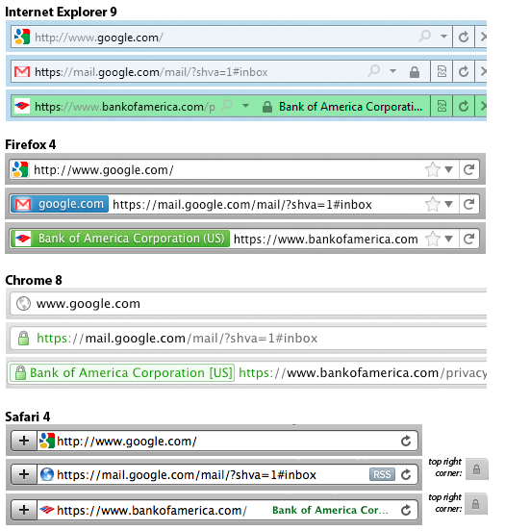
The Meaning of Color
What is the difference?
Domain Validation (DV) certificate
vs.
Extended Validation (EV) certificate
Means what?
Source: Schulze

Slide 35
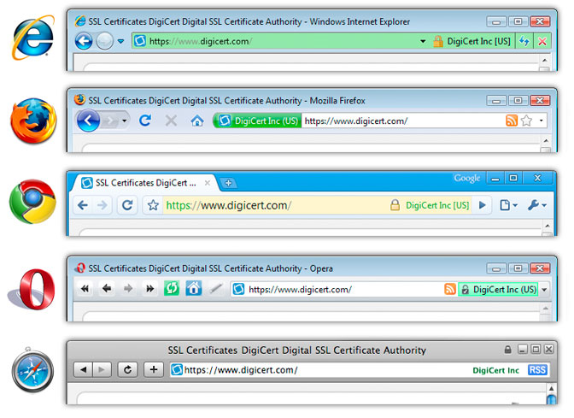
Extended Validation (EV) Certificates
EV certificate request must be approved by a human at the certificate authority
Helps block “semantic attacks”: Remember www.bankofthevvest.com?
UI ineffective, removed from Chrome in 2019

Slide 36
Questions About EV Certificates
What does EV certificate mean?
What is the difference between an HTTPS connection that uses a regular certificate and an HTTPS connection that uses an EV certificate?
If an attacker has somehow obtained a non-EV certificate for bank.com, can he inject a script into https://bank.com content?
What is the origin of the script? Can it access or modify content that arrived from actual bank.com via HTTPS?
What would the browser show – blue or green?

Slide 37
CA Hierarchy
Browsers, operating systems, etc. have trusted root certificate authorities
Chrome includes certificates of ~200 trusted root CAs
Root CA signs certificates for intermediate CAs, they sign certificates for lower-level CAs, etc.
“Chain of trust”: sig_{Verisign}(“Cornell”, PK_{Cornell}), sig_{Cornell}(“Vitaly S.”, PK_{Vitaly})
CAs are responsible for verifying the identities of certificate requestors, domain ownership

Slide 38
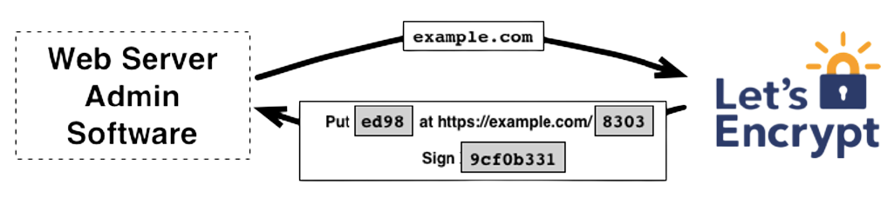
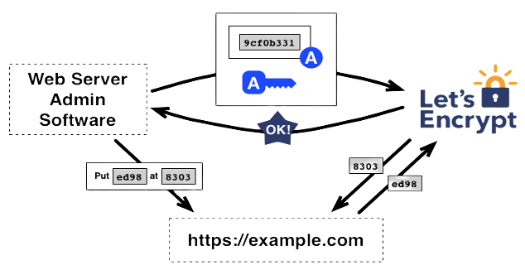


Certificate Issuance
How does this work with wildcard certificates like *.cornell.edu?
Free CA!
CA gives a challenge to the requester
By putting a signed challenge on the website, requester proves that he controls the website and knows the signing key (why?)

Slide 39
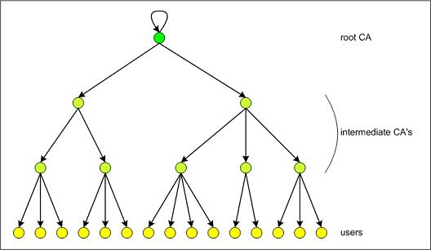
Certificate Hierarchy
What power do they have?
Who trusts their certificates?

Slide 40
How Many?
“1,800 entities that are able to issue certificates vouching for the identity of any website”
Durumeric et al. Analysis of the HTTPS Certificate Ecosystem (2013)
A public key for any website in the world will be accepted by the browser if the certificate is signed by one of these CAs

Slide 41
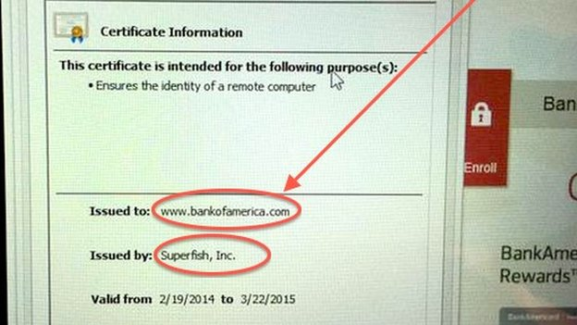
Another Example of a Certificate

Slide 42
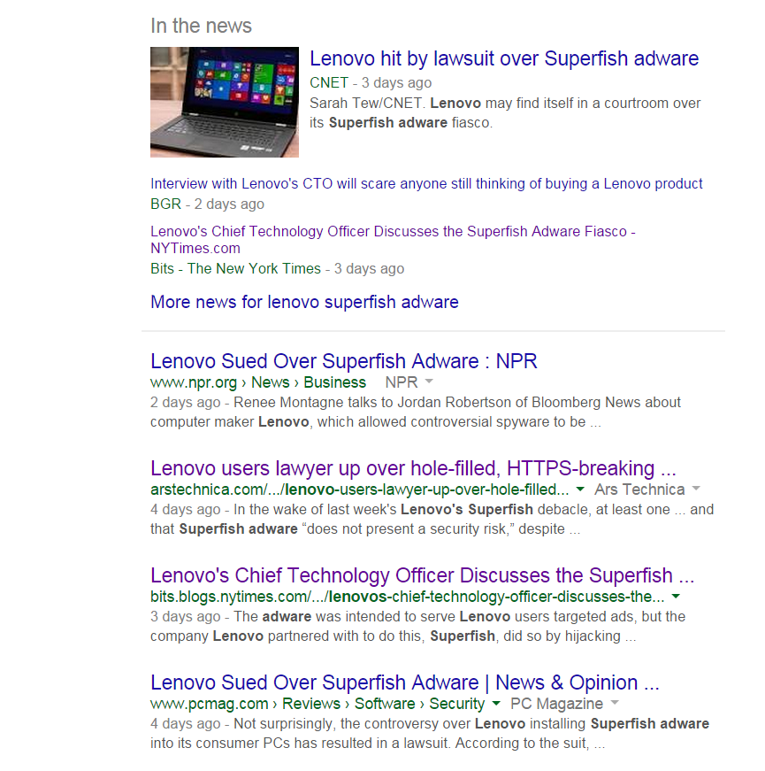
Root Certificates in Lenovo Laptops (2015)

Slide 43
What Could You Do …
… if you had a certificate for cornell.edu signed by a root CA?

Slide 44
Man-in-the-Middle (MITM) Attack
Read all traffic, undetected
Impersonate any website, undetected
browser
root CA

Slide 45
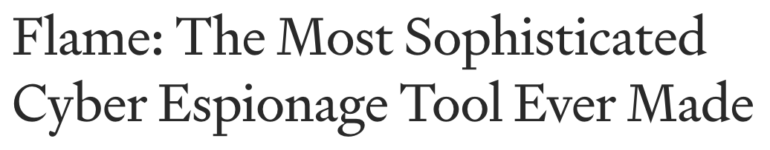
Flame
Cyber-espionage virus (2010-2012)
Signed with a fake intermediate CA certificate accepted by any Windows Update service
Fake certificate was created using an MD5 chosen-prefix collision against an obscure Microsoft Terminal Server Licensing Service certificate that was enabled for code signing
MD5 collision technique possibly pre-dates academic publication of MD5 collisions
Evidence of state-level cryptanalysis?

Slide 46

Comodo is one of the trusted root CAs
Its certificates for any website in the world are accepted by every browser
Comodo accepts certificate orders submitted through resellers
Reseller uses a program to authenticate to Comodo and submit an order with a domain name and public key, Comodo automatically issues a certificate for this site

Slide 47
Comodo Break-In
An Iranian hacker broke into instantSSL.it and globalTrust.it resellers, decompiled their certificate issuance program, learned the credentials of their reseller account and how to use Comodo API
username: gtadmin, password: globaltrust
Wrote his own program for submitting orders and obtaining Comodo certificates
On March 15, 2011, got Comodo to issue 9 rogue certificates for popular sites
mail.google.com, login.live.com, login.yahoo.com, login.skype.com, addons.mozilla.org, “global trustee”
What are potential consequences?

Slide 48
Message from the Attacker
http://pastebin.com/74KXCaEZ
I'm single hacker with experience of 1000 hacker, I'm single programmer with experience of 1000 programmer, I'm single planner/project manager with experience of 1000 project managers …
When USA and Isarel could read my emails in Yahoo, Hotmail, Skype, Gmail, etc. without any simple little problem, when they can spy using Echelon, I can do anything I can. It's a simple rule. You do, I do, that's all. You stop, I stop. It's rule #1 …
Rule#2: So why all the world got worried, internet shocked and all writers write about it, but nobody writes about Stuxnet anymore?... So nobody should write about SSL certificates.
Rule#3: I won't let anyone inside Iran, harm people of Iran, harm my country's Nuclear Scientists, harm my Leader (which nobody can), harm my President, as I live, you won't be able to do so. as I live, you don't have privacy in internet, you don't have security in digital world, just wait and see...

Slide 49
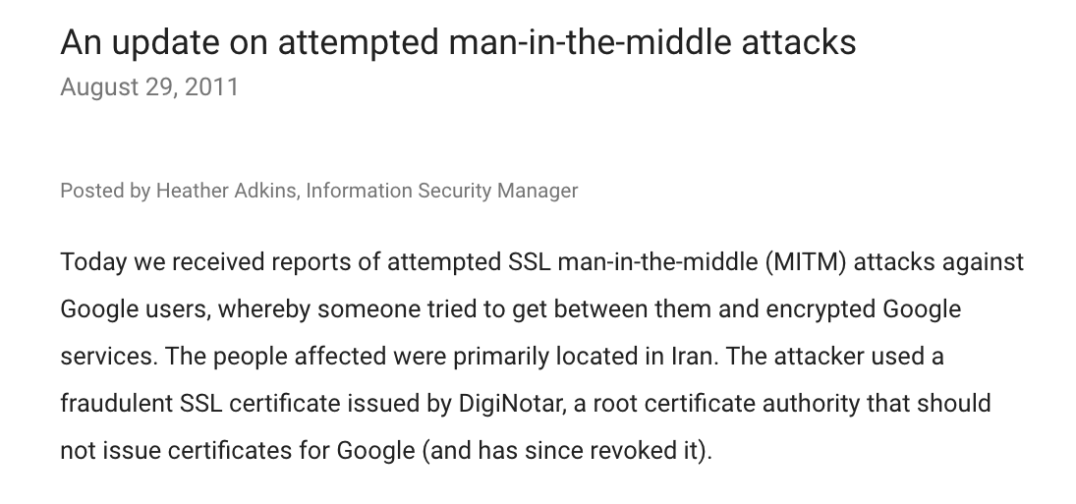



Slide 50


DigiNotar Break-In
In June 2011, “ComodoHacker” broke into a Dutch certificate authority, DigiNotar
Security of DigiNotar servers:
All core certificate servers in a single Windows domain, controlled by a single admin password (Pr0d@dm1n)
Software on public-facing servers out of date, unpatched
Tools used in the attack would have been easily detected by an antivirus… if it had been present
Message found in scripts used to generate fake certificates: “THERE IS NO ANY HARDWARE OR SOFTWARE IN THIS WORLD EXISTS WHICH COULD STOP MY HEAVY ATTACKS MY BRAIN OR MY SKILLS OR MY WILL OR MY EXPERTISE"

Slide 51

Consequences of the DigiNotar Hack
Break-in not detected for a month
Rogue certificates issued for *.google.com, Skype, Facebook, www.cia.gov, and 527 other domains
99% of revocation lookups for these certificates originated from Iran
Evidence that rogue certificates were being used, most likely by Iranian government or Iranian ISPs to intercept encrypted communications
300,000 users were served rogue certificates (95% in Iran)
Textbook “man in the middle”

Slide 52
Another Message from the Attacker
http://pastebin.com/u/ComodoHacker
Most sophisticated hack of all time … I’m really sharp, powerful, dangerous and smart!
My country should have control over Google, Skype, Yahoo, etc. […] I’m breaking all encryption algorithms and giving power to my country to control all of them.
You only heards Comodo (successfully issued 9 certs for me -thanks by the way-), DigiNotar (successfully generated 500+ code signing and SSL certs for me -thanks again-), StartCOM (got connection to HSM, was generating for twitter, google, etc. CEO was lucky enough, but I have ALL emails, database backups, customer data which I'll publish all via cryptome in near future), GlobalSign (I have access to their entire server, got DB backups, their linux / tar gzipped and downloaded, I even have private key of their OWN globalsign.com domain, hahahaa).... BUT YOU HAVE TO HEAR SO MUCH MORE! SO MUCH MORE! At least 3 more, AT LEAST

Slide 53

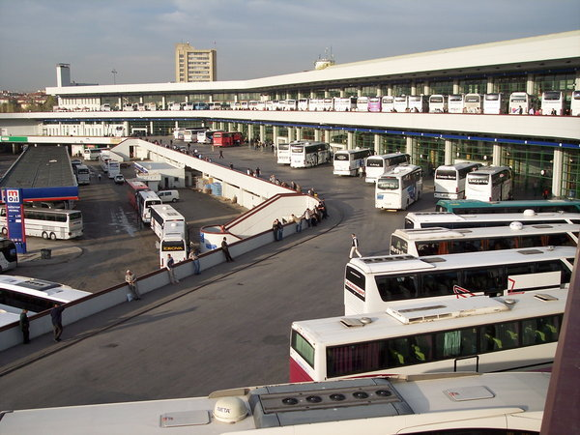
Rogue Certificates in the Wild
In Jan 2013, TurkTrust (a root CA) accidentally issued intermediate CA certificates to customers who requested regular certificates
Ankara transit authority used its certificate to issue a fake *.google.com certificate in order to intercept and filter SSL traffic from its network
More rogue certs (2015)
MCS Holdings (Egypt) for Google domains
Root CA: CNNIC (China)
WoSign (Chinese CA) for Github and Alibaba
These guys gained the ability to intercept HTTPS traffic to any website in the world

Slide 54

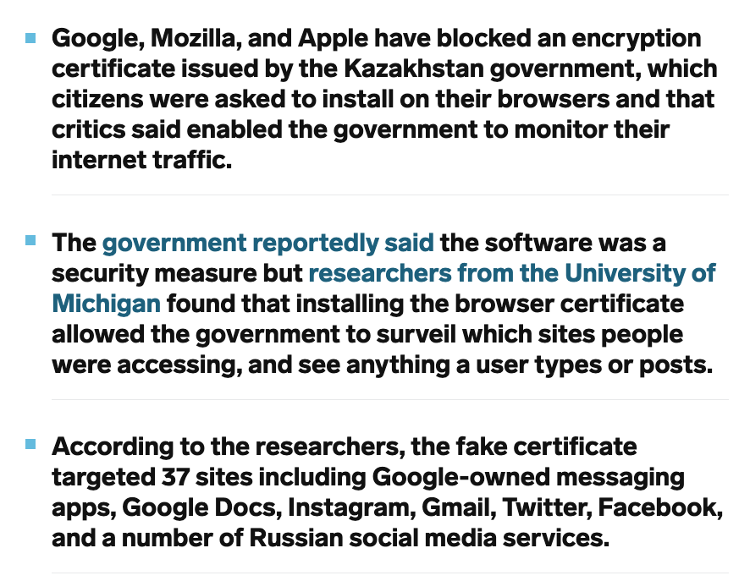

Rogue Certs for Surveillance
https://www.businessinsider.com/apple-google-mozilla-block-kazakhstan-governments-browser-spying-tool-2019-8

Slide 55

In Feb 2012, TrustWave admitted issuing an intermediate CA certificate to a corporate customer
Purpose: “re-sign” certificates for “data loss prevention”
Translation: forge certificates of third-party sites in order to spy on employees’ encrypted communications with the outside world
Customer can now forge certificates for any site in world… and they will be accepted by any browser!
What if a “re-signed” certificate leaks out?

Slide 56

Software behind the Superfish / Lenovo scandal
Defunct Israeli startup
Installed its own root certificate
Goal: re-sign SSL certificates, proxy/MITM connections
From their former website: “Our advanced SSL hijacker SDK is a brand new technology that allows you to access data that was encrypted using SSL and perform on the fly SSL decryption.”
Same private key on all machines, easily extracted
Anyone could issue fake Komodia certificates, MITM any machine with Komodia
Also turned self-signed certificates into trusted certificates

Slide 57
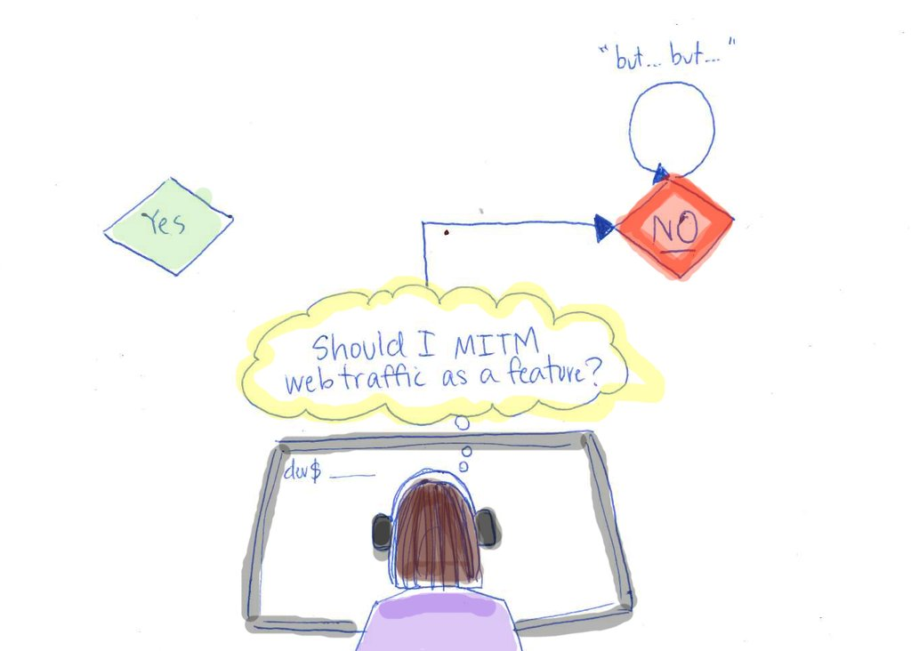
Credit: Adrienne Porter Felt (Google)

Slide 58
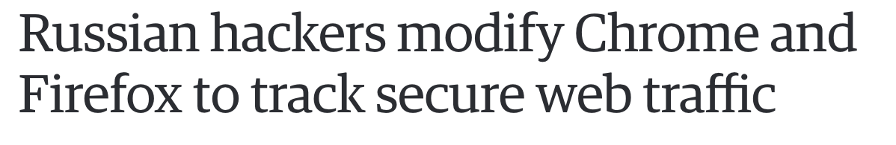
Malware installs its own certificate
Modifies pseudo-random generator to add encrypted hardware and software identifiers of the infected machine to the random nonce sent as part of the TLS handshake
https://securelist.com/compfun-successor-reductor/93633/

Slide 59
Revoking Certificates
Short expirations
CRLs (certificate revocation lists)
OCSP (online certificate status protocol)
Client queries CA to check validity of cert
Privacy concerns, performance / scalability issues
Stapling: website periodically gets fresh, time-stamped OCSP signature from CA, includes it with the certificate
Certs can have “must staple” extension

Slide 60
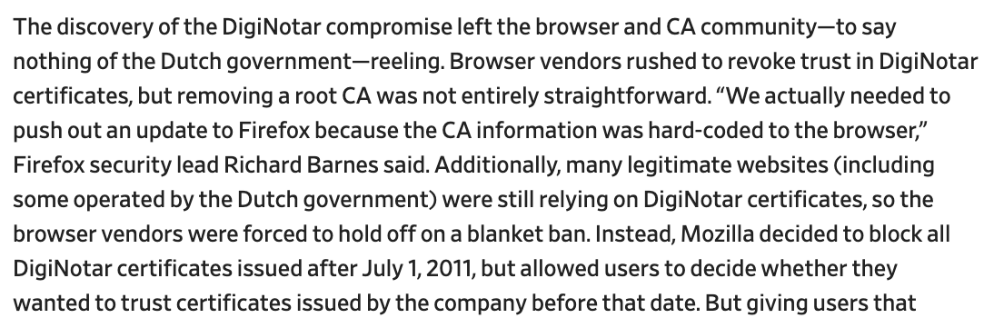
Revoking DigiNotar Certificates
In the Netherlands, interior minister went on TV to warn Dutch citizens to immediately stop using secure government websites
https://slate.com/technology/2016/12/how-the-2011-hack-of-diginotar-changed-the-internets-infrastructure.html

Slide 61
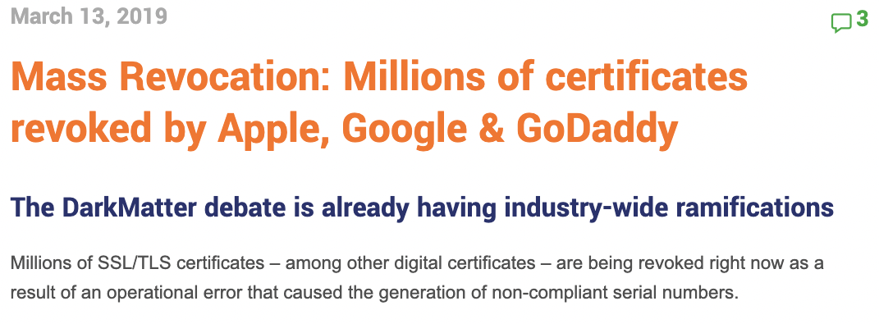
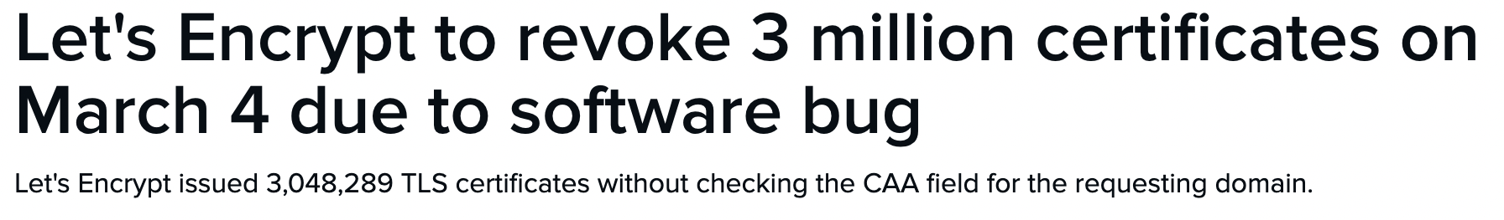

https://www.thesslstore.com/blog/mass-revocation-millions-of-certificates-revoked-by-apple-google-godaddy/
Domain owners use CAA field to restrict which CAs can issue their certs
https://www.zdnet.com/article/lets-encrypt-to-revoke-3-million-certificates-on-march-4-due-to-bug/

Slide 62
Certificate / Public Key Pinning
Idea: client knows what cert/PK to expect, rejects anything else
How?
Pre-install some keys
HPKP (HTTP Public Key Pinning): site can use an HTTP header to let clients know the hash of public key the site will use
What if the site is hacked?
Attacker pins his own key!
Public-Key-Pins:
pin-sha256="d6qzRu9zOECb90Uez27xWltNsj0e1Md7GkYYkVoZWmM=";
pin-sha256="LPJNul+wow4m6DsqxbninhsWHlwfp0JecwQzYpOLmCQ=";
max-age=259200
Note: Chrome never accepted fake DigitNotar certs

Slide 63
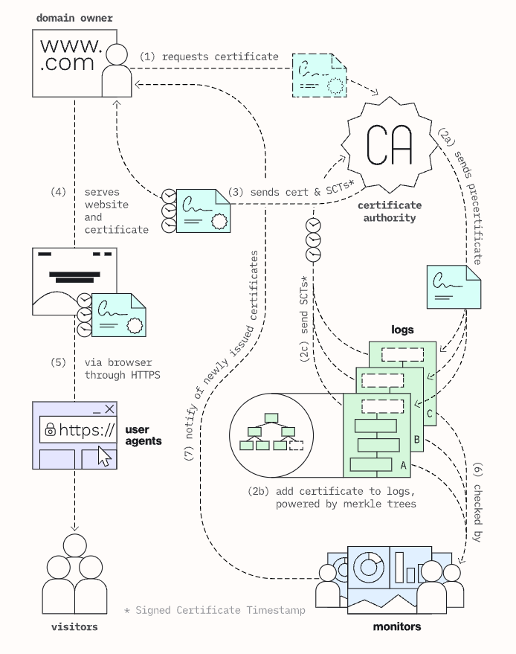
Certificate Transparency
Force CAs to log the certificates they sign in a public tamper-evident register
Server attaches a signed statement from log (SCT) to certificate
Browser will only use a cert if it is published on two log servers
Companies can scan logs to look for invalid issuance
Google has been pushing this (+ has its own CA)
Chrome requires it for EV certs + certs with path to root CA
If certificate is not logged, will users pay attention to browser warnings?
How does this compare to OCSP?

Slide 64
Peeking Through SSL/TLS
Network traffic reveals length of HTTPS packets
TLS supports up to 256 bytes of padding
AJAX-rich pages have lots and lots of interactions with the server
These interactions expose specific internal state of the page

Slide 65
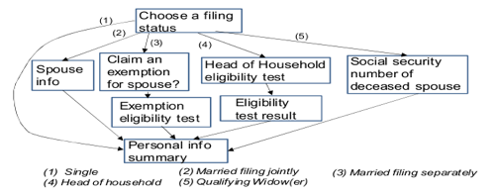
Traffic Analysis: Online Tax Software
Sizes of webpages identify the state of the application, which leaks information about the user’s inputs
Chen et al. “Side-Channel Leaks in Web Applications: a Reality Today, a Challenge Tomorrow”

Slide 66
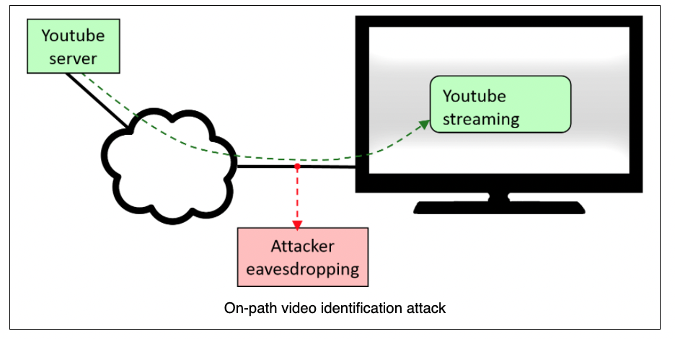
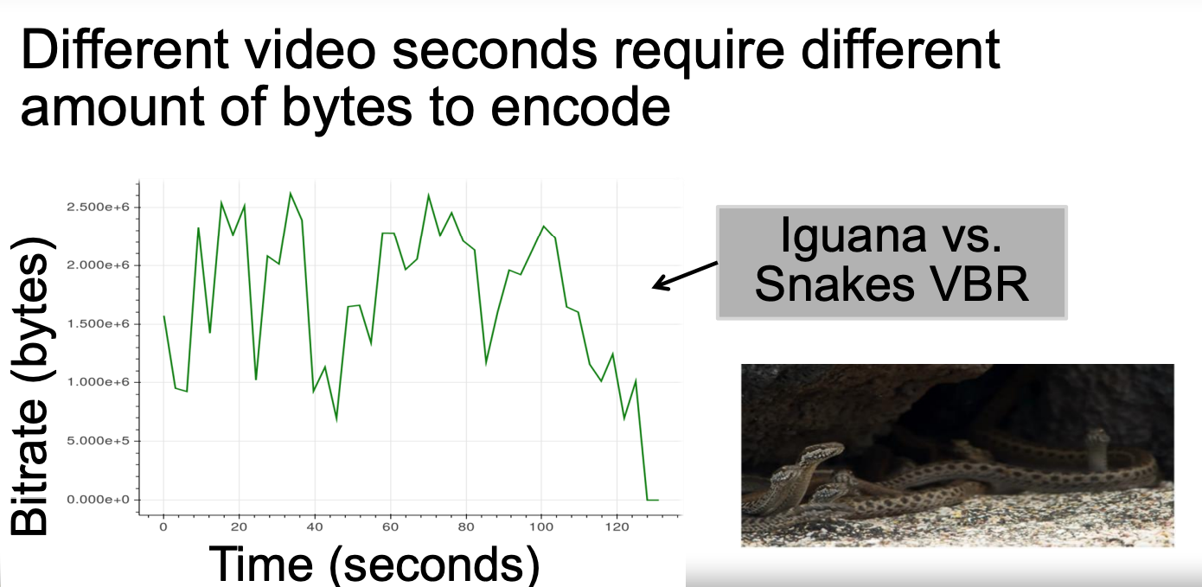
Traffic Analysis: Video Streaming
Patterns of traffic bursts in encrypted video streams due to variable-bitrate encoding identify specific YouTube and Netflix videos
Schuster et al. “Beauty and the Burst: Remote Identification of Encrypted Video Streams”

